Slide 1
Python-Flow Control, Loops and Functions
Feb 10, 2012
Eman Ghobrial

Slide 2
If, elif and else

Slide 3
For loop
range statement
range(5) is [0, 1, 2, 3, 4]
range (0,8,2) is [0,2,4,6]
for j in range (5):
print j

Slide 4
While Loop

Slide 5
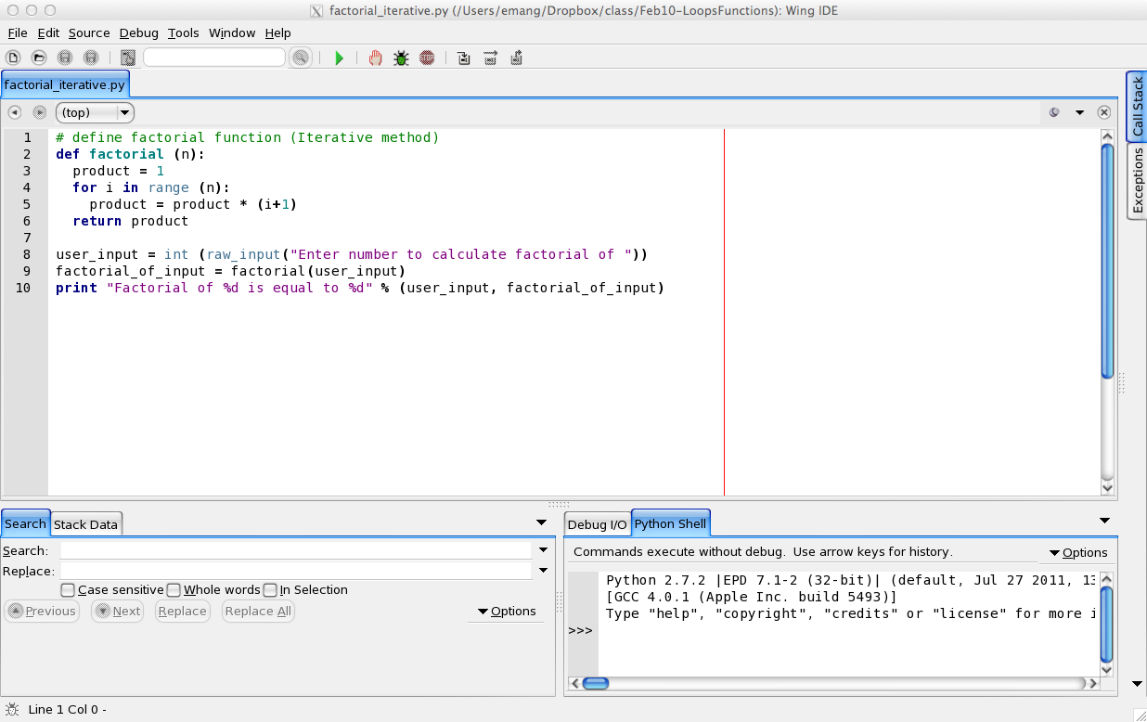
Iterative vs Recursive method (function)

Slide 6
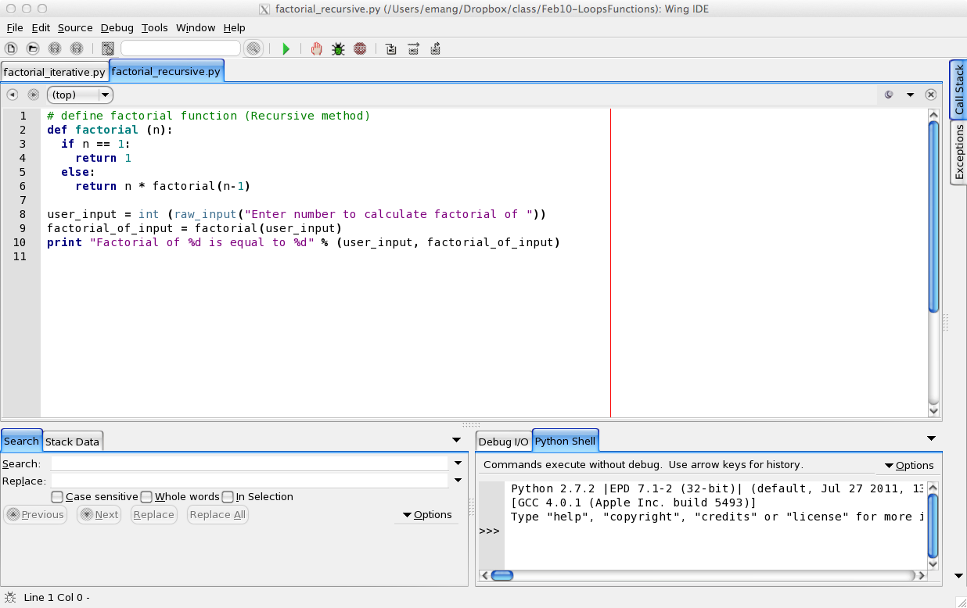
Recursive method

Slide 7
Answers

Slide 8
If, elif and else - Excerise

Slide 9
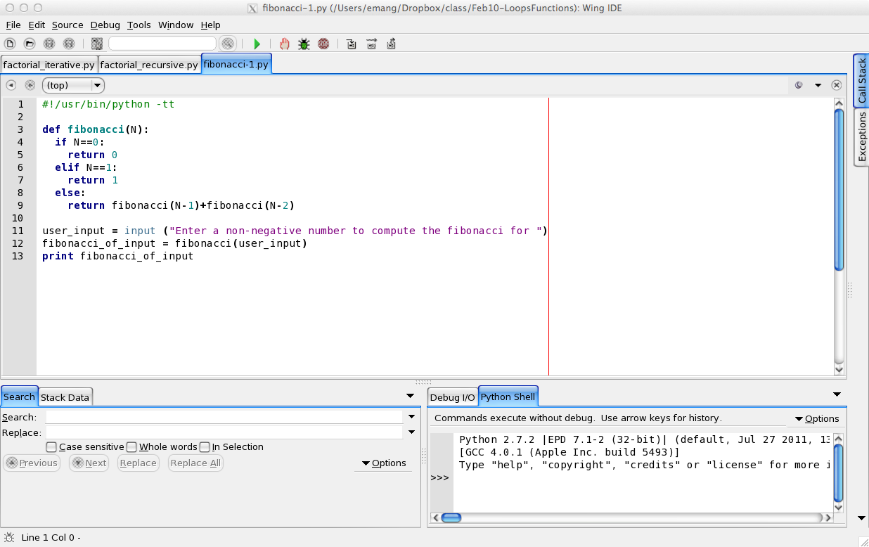
Fibonacci – Recursive Function

